Slide 1
Health Care Data Analysis

Slide 2
Objective
Analyze patient demographics
Identify major disease patterns
Understand ICU occupancy and performance
Improve hospital resource planning
Support data-driven healthcare decisions

Slide 3
Dataset Description
Patient demographics
Disease indicators (DM, HTN, CKD, ACS, etc.)
Hospital & ICU stay duration
Rural/Urban status
Admissions (2017–2019)

Slide 4
Data Cleaning Steps
Corrected data types
Removed empty rows
Converted 0/1 medical flags to Yes/No
Created Age Groups & Weekday columns
Built Date Table
Handled missing values

Slide 5
Data Modeling
Star schema (1 Fact + Date dimension)
Key DAX measures (TotalPatients, AvgStay, Male%, ICU_Avg)
Calculated columns (AgeGroup, WeekDayName, ComorbidityCount)

Slide 6
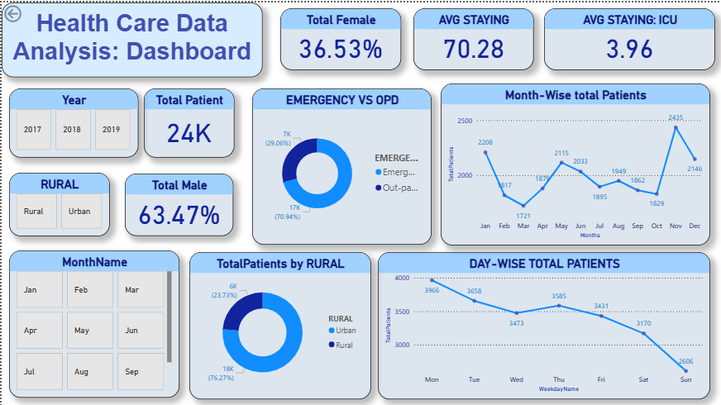
Dashboard- EXECUTIVE

Slide 7
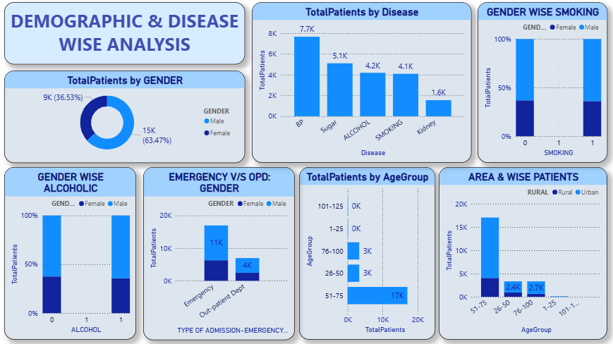
Dashboard- DEMOGRAPHIC

Slide 8
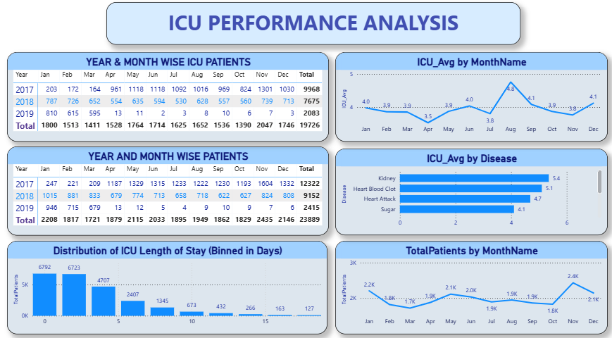
Dashboard: ICU PERFORMANCE

Slide 9
Key Insights
Admissions highest in Jan & Dec
63% male, 37% female patients
Rural patients ~67% of total
70% cases are Emergency admissions
Most admissions Mon–Tue
Top diseases: BP, Sugar, Alcohol, Smoking, Kidney
ICU stay longest for kidney & cardiac cases

Slide 10
Recommendations
Increase staff during Jan–Feb–Dec
Strengthen cardiac & renal care units
Improve weekend emergency staffing
Run rural disease awareness programs

Slide 11
Conclusion
Dashboard provides full insight into disease burden, ICU load, and patient demographics.
Supports hospital decision-making and resource optimization.

